Slide 1

BLOCKCHAIN IN ADVERTISING - DECENTRALIZED DEMAND SIDE PLATFORM (DSP)

Slide 2

INTRODUCTION
Welcome to the world of decentralized advertising! Today, we are excited to introduce you to our Decentralized Demand Side Platform (DSP) for advertising. Our platform is built on blockchain technology, which ensures transparency, security, and efficiency in the advertising ecosystem. With our DSP, advertisers can reach their target audience without any middlemen or intermediaries. Our primary goal is to revolutionize the advertising industry by providing a decentralized platform that is accessible to everyone.

Slide 3
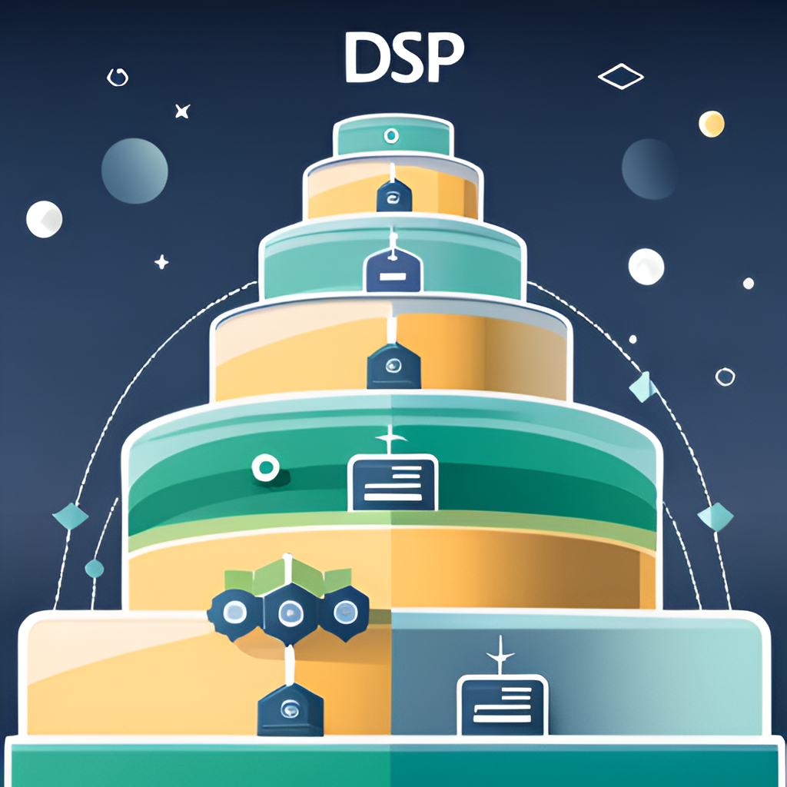
TECHNICAL ARCHITECTURE
The DSP is structured into three layers: Presentation, Application, and Data.
Presentation Tier
The Presentation Tier of the Decentralized Demand Side Platform (DSP) is managed by a Flask application, which provides a robust and scalable framework for building web applications.
Application Tier
Handles the core business logic and interaction with the blockchain. It consists of a Flask application that communicates with the Presentation Tier and Data Tier. The AdCampaign smart contract (ad.sol) defines the structure of advertising campaigns and is responsible for managing the flow of funds between advertisers and publishers.
Data Layer
The Data Tier of the Decentralized Demand Side Platform (DSP) is responsible for storing and managing all data related to advertising campaigns. This includes information about the Advertisers, their target audience, budget, and other relevant details.

Slide 4


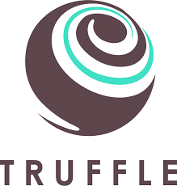
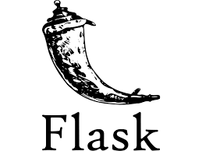

TECHNICAL IMPLEMENTATION
The DSP is implemented using Flask, Geth, Truffle, Solidity, Remix IDE and Python.

Slide 5
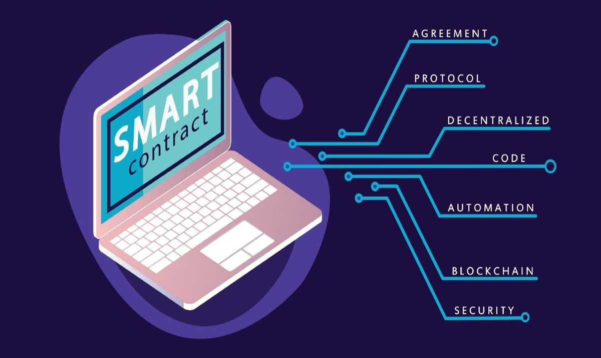

AdCampaigns Smart Contract
It is a Solidity-based contract designed to facilitate and manage advertising campaigns on the Ethereum blockchain. It employs a struct named Campaign to encapsulate essential details of each campaign, such as the advertiser's address, budget, reward, and activation status.
Key Components
1. Campaign Struct: Each advertising campaign is represented by an instance of the Campaign struct, providing a structured way to store and retrieve campaign information.
2. Data Storage: The contract utilizes a mapping, campaigns, to associate a unique identifier (campaign ID) with the corresponding Campaign struct, enabling efficient storage and retrieval of campaign data.
3. Functions: 1. createCampaign: Allows users to create new Ad Campaign.
2. toggleCampaignStatus: Permits the advertiser to toggle the activation status of a campaign.
4. Campaign Counter: This private variable keeps track of the total number of campaigns created, ensuring the uniqueness of each campaign ID.

Slide 6

BENEFITS
One of the key benefits of using a decentralized DSP for advertising is increased transparency. With traditional advertising methods, it can be difficult to track where ad spend is going and whether or not it's being used effectively. However, with a decentralized DSP, advertisers can see exactly where their money is going and how it's being used in real-time.
Another benefit of using a decentralized DSP is increased efficiency. By removing intermediaries and allowing advertisers to interact directly with publishers, transactions can be completed faster and more efficiently. This means that campaigns can be launched and adjusted more quickly, leading to better results and a higher return on investment.

Slide 7

CONCLUSION
The Decentralized Demand Side Platform (DSP) for advertising offers a revolutionary solution to the challenges faced by the traditional advertising ecosystem. By leveraging blockchain technology, the DSP provides increased transparency, efficiency, and security, which are crucial factors in today's digital landscape.

Slide 8
THANK YOU
Made By
Name: Jeet Chovatia
Enrolment No: 12020002016049
Roll No: 38
Department: CSE(AIML)

